Slide 1



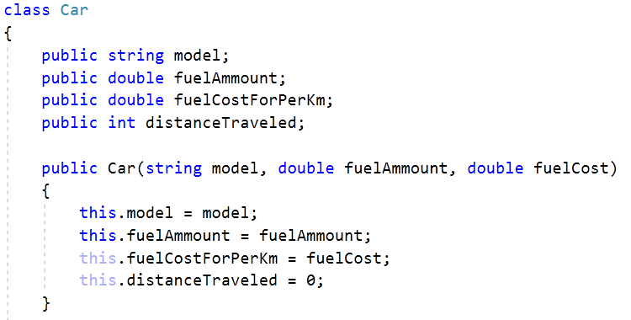

Working with Abstraction
Architecture, Refactoring and Enumerations
Advanced
C#
SoftUni Team
Technical Trainers
Software University
http://softuni.bg

Slide 2

Table of Contents
Project Architecture
Methods
Classes
Projects
Code Refactoring
Enumerations

Slide 3
Questions
sli.do #CSharp-Fund

Slide 4
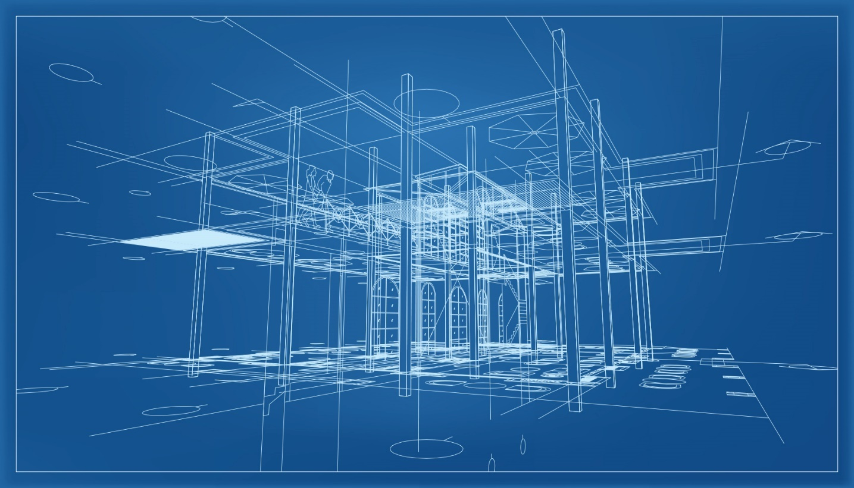
Project Architecture
Splitting Code into Logical Parts

Slide 5


Splitting Code into Methods
We use methods to split code into functional blocks
Improves code readability
Allows for easier debugging
foreach (char move in moves)
{
for (int row = 0;
row < room.Length; row++)
{
for (int col = 0;
col < room[row].Length; col++)
{
if (room[row][col] == 'b')
…
foreach (char move in moves)
{
MoveEnemies();
KillerCheck();
MovePlayer(move);
…

Slide 6

Splitting Code into Methods (2)
Methods let us easily reuse code
We change the method once to affect all calls
var bankAcc = new BankAccount();
bankAcc.Id = 1;
bankAcc.Deposit(20);
Console.WriteLine($"Account {bankAcc.Id}, balance {bankAcc.Balance}");
bankAcc.Withdraw(10);
…
Console.WriteLine($"Account {bankAcc.Id}, balance {bankAcc.Balance}");
Override .ToString() to set a global printing format
Console.WriteLine(bankAcc.ToString());

Slide 7
Splitting Code into Methods (3)
A single method should complete a single task
void Withdraw ( … )
void Deposit ( … )
decimal GetBalance ( … )
string ToString ( … )
void DoMagic ( … )
void DepositOrWithdraw ( … )
decimal DepositAndGetBalance ( … )
string ParseDataAndReturnResult ( … )

Slide 8
Problem: Rhombus of Stars
Draw on the console a rhombus of stars with size n
n = 3
n = 2
n = 1
*
* *
* * *
* *
*
*
* *
*
*

Slide 9
Solution: Rhombus of Stars
static void Main()
{
int size = int.Parse(Console.ReadLine());
for (int starCount = 1; starCount <= size; starCount++)
{
PrintRow(size, starCount);
}
for (int starCount = size - 1; starCount >= 1; starCount--)
{
PrintRow(size, starCount);
}
}
Reusing code

Slide 10
Solution: Rhombus of Stars (2)
static void PrintRow(int figureSize, int starCount)
{
for (int i = 0; i < figureSize - starCount; i++)
{
Console.Write(" ");
}
for (int col = 1; col < starCount; col++)
{
Console.Write("* ");
}
Console.WriteLine("*");
}

Slide 11
Splitting Code into Classes
Just like methods, classes should not know or do too much
int[] numbers = args.Split().Select(int.Parse).ToArray();
...
Console.Write(string.Join(" ", numbers));
GodMode master = new GodMode();
int[] numbers = master.ParseAny(args);
...
int[] numbers2 = master.CopyAny(numbers);
master.PrintToConsole(master.GetDate());
master.PrintToConsole(numbers);

Slide 12
Splitting Code into Classes (2)
We can also break our code up logically into classes
int[] numbers = args.Split().Select(int.Parse).ToArray();
. . .
Console.Write(string.Join(" ", numbers));
Hiding implementation
ArrayParser parser = new ArrayParser();
OuputWriter printer = new OuputWriter();
int[] numbers = parser.IntegersParse(args);
int[] coordinates = parser.IntegerParse(args1);
printer.PrintToConsole(numbers);
Allow us to change output destination
Helps us avoid repeating code

Slide 13
Problem: Point in Rectangle
Create a Point class holding the horizontal and vertical coordinates.
Create a Rectangle class that holds one of the sides (that’s your abstraction, you don’t need more).
Add Contains method in the Rectangle class that takes a Point as an argument and returns if it’s inside the current object of the Rectangle class.

Slide 14
Solution: Point in Rectangle
0
2
4
6
8
10
12
-5
topLeft
public class Rectangle
{
private Point topLeft;
private Point bottomRight;
//TODO: Public properties
public bool Contains(Point point)
{
//TODO: Implement
}
}
-3
-1
x, y
1
3
5
bottomRight
public class Point
{
private int x;
private int y;
//TODO: Public properties
}

Slide 15
Solution: Point in Rectangle (2)
public bool Contains(Point point)
{
bool isInHorizontal = this.TopLeft.X <= point.X && this.BottomRight.X >= point.X;
bool isInVertical = this.TopLeft.Y <= point.Y && this.BottomRight.Y >= point.Y;
bool isInRectangle = isInHorizontal && isInVertical
return isInRectangle;
}

Slide 16

Refactoring
Restructuring and Organizing Code

Slide 17
Refactoring
Restructuring code without changing the behaviour
Improves code readability
Reduces complexity
class ProblemSolver { public static void DoMagic() { … } }
class CommandParser { public static Func<T, T> ParseCommand(); }
class DataModifier { public static T Execute(); … }
class OutputFormatter { public static void Print(); … }

Slide 18
Refactoring Techniques
Componentization - breaking code apart reusable units
Extracting parts of methods and classes into new ones
Deposit()
Withdraw()
DepositOrWithdraw()
Improving names of variables, methods, classes, etc.
string str;
string name;
Moving methods or fields to more appropriate classes
Car.Open()
Door.Open()

Slide 19
Problem: Student System
You are given a working Student System project to refactor
Break it up into smaller functional units and make sure it works
It supports the following commands:
"Create <studentName> <studentAge> <studentGrade>" – creates a new student.
"Show <studentName>" – prints information about a student
"Exit" – closes the program.

Slide 20
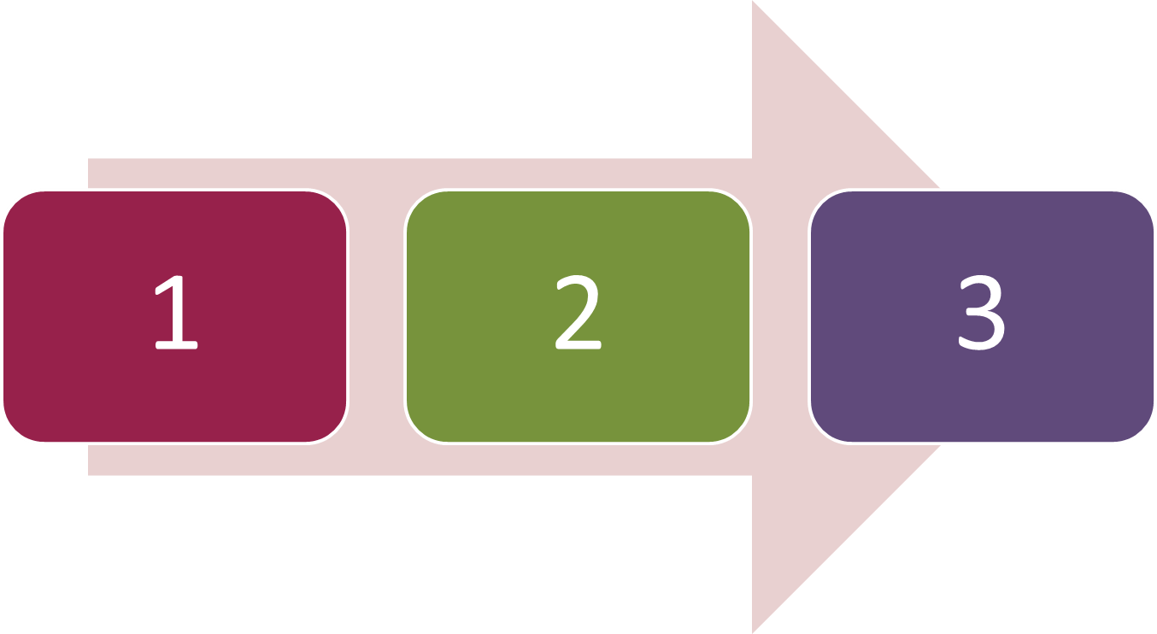
Enumerations
Syntax and Usage

Slide 21
Enumerations
Enumerations represent a numeric value from a fixed set as text
We can use them to pass arguments to methods without making code confusing
GetDailySchedule(0)
GetDailySchedule(Day.Mon)
enum Day { Mon, Tue, Wed, Thu, Fri, Sat, Sun }
Use the enum keyword
By default, enums start at 0
Every next value is incremented by 1

Slide 22




Enumerations (2)
We can customize enum values
enum Day
{
Mon = 1,
Tue, //2
Wed, //3
Thu, //4
Fri, //5
Sat, //6
Sun //7
}
enum CoffeeSize
{
Small = 100,
Normal = 150,
Double = 300
}

Slide 23

Problem: Hotel Reservation
Create a class PriceCalculator that calculates the total price of a holiday, given the price per day, number of days, the season and a discount type
The discount type and season should be enums
The price multipliers will be:
1x for Autumn, 2x for Spring, etc.
The discount types will be:
None – 0%
SecondVisit – 10%
VIP – 20%

Slide 24
Solution: Hotel Reservation
public enum Discount
{
None,
SecondVisit = 10,
VIP = 20
}
public enum Season
{
Spring = 2,
Summer = 4,
Autumn = 1,
Winter = 3
}

Slide 25

Solution: Hotel Reservation (2)
Now, use the class like this:
Read input from the console
Parse it and call the CalculatePrice() method
50.25 5 Summer VIP
804.00
40 10 Autumn SecondVisit
360.00
120.20 2 Winter
721.20
The discount input may be omitted!

Slide 26
Solution: Hotel Reservation (2)
public decimal CalculatePrice (decimal pricePerDay,
int numberOfDays, Season season, Discount discount)
{
int multiplier = (int)season;
decimal discountMultiplier = (decimal)discount / 100;
decimal priceBeforeDiscount =
numberOfDays * pricePerDay * multiplier;
decimal discountedAmount =
priceBeforeDiscount * discountMultiplier;
decimal finalPrice =
priceBeforeDiscount - discountedAmount;
return finalPrice;
}
We can cast enums to numeric values

Slide 27
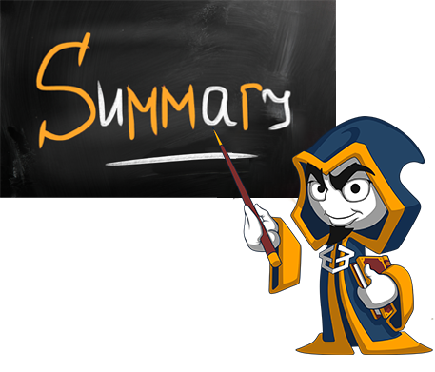
Summary
Well organized code is easier to work with
We can reduce complexity using
Methods
Classes
Projects
We can refactor existing code by
Breaking code apart
Improving names and locations

Slide 28
Summary (2)
Enumerations define a fixed set of constants
E.g. the days of the week
They represent numeric values with more readability
We can easily cast enums to numeric data types

Slide 29







Working with Abstraction
https://softuni.bg/courses/csharp-advanced

Slide 30
License
This course (slides, examples, demos, videos, homework, etc.) is licensed under the "Creative Commons Attribution-NonCommercial-ShareAlike 4.0 International" license
Attribution: this work may contain portions from
"Fundamentals of Computer Programming with C#" book by Svetlin Nakov & Co. under CC-BY-SA license
"C# Part I" course by Telerik Academy under CC-BY-NC-SA license
"C# Part II" course by Telerik Academy under CC-BY-NC-SA license

Slide 31





Trainings @ Software University (SoftUni)
Software University – High-Quality Education, Profession and Job for Software Developers
softuni.bg
Software University Foundation
http://softuni.foundation/
Software University @ Facebook
facebook.com/SoftwareUniversity
Software University Forums
forum.softuni.bg

